Slide 1
Query Processing- Part 1

Slide 2
Query Operators & Algebraic Expressions

Slide 3
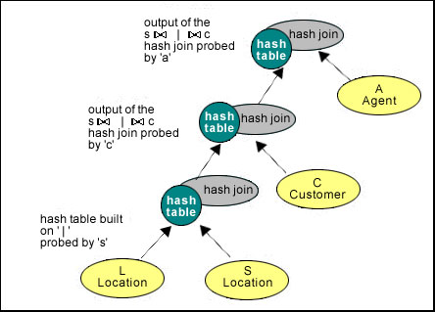
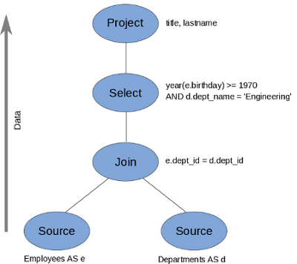
SQL & Query Processing
SQL Query
SELECT pNumber, count(*) AS CNT
FROM Student
WHERE sNumber > 1
GROUP BY pNumber;
Query Plans

Slide 4
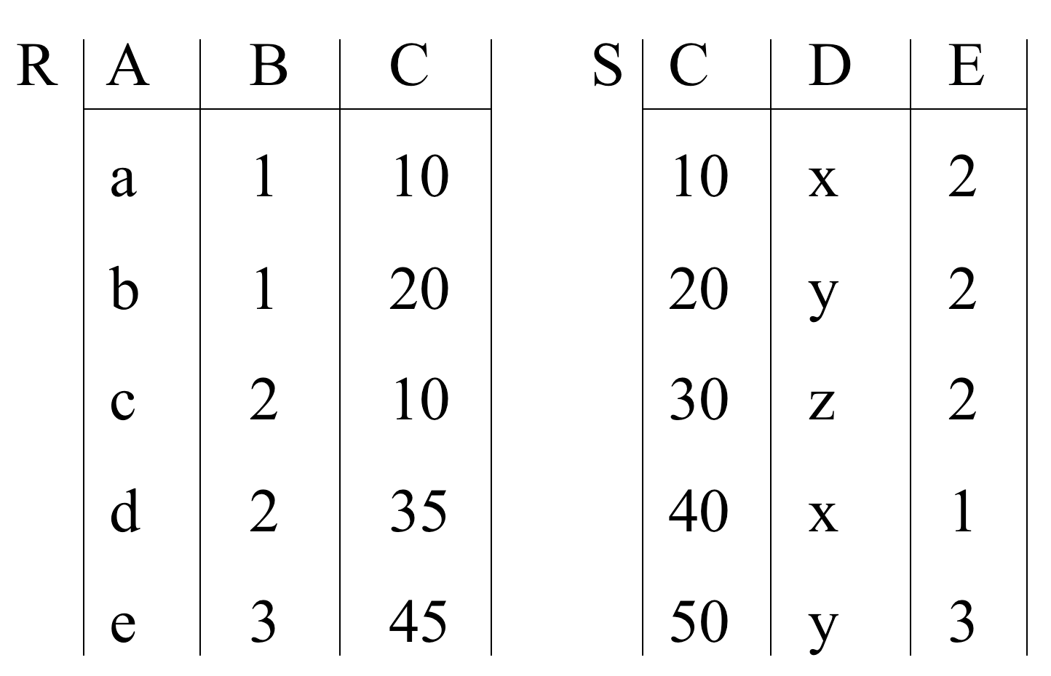
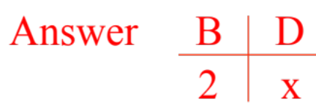
Query Example
SELECT B, D FROM R, S WHERE R.A = “c” and S.E = 2 and R.C=S.C

Slide 5
R X S R.A R.B R.C S.C S.D S.E
a 1 10 10 x 2
a 1 10 20 y 2
.
.
C 2 10 10 x 2
.
.
One Way
Bingo!
Got one...
SELECT B, D FROM R, S WHERE R.A = “c” and S.E = 2 and R.C=S.C

Slide 6
Relational Algebra Express Query Plans
Π_{B,D}
σ_{R.A=“c” & S.E=2 & R.C=S.C}
 X
R S

Slide 7
But ?
Performance would be unacceptable!
We need a better approach for reasoning about queries, their execution orders and their respective costs

Slide 8
Formal Relational Query Languages
Relational Algebra: More operational, very useful for representing execution plans.
Operators working on relations

Slide 9
Core Relational Algebra (Recap)
R U S
R ∩ S
R - S
Union, intersection, and difference.
  Usual set operations, both operands have the same relation schema.
Selection: picking certain rows.
Projection: picking certain columns.
Products and joins: compositions of relations.
Grouping and Aggregation: Grouping matching tuples
Duplicate Elimination: eliminates identical copies except one
Sorting: Orders tuples based on a given criteria
σ_{c} (R)
^{Π}_{B,D, …}(R)
R X S
R ⋈_{c} S
  _{ϒg1,g2, …gm, F1(A1), …Fn(An)} (R)
δ (R)
^{τ}_{x}(R)

Slide 10
Your Exercise
Remember the SQL Operators
Know the semantics and Symbol of each one
Given a SQL query in text, translate it to an algebraic expression
What are the output schemas from each operator

Slide 11
Example
Data:
relation R (A, B, C)
relation S (C, D, E)
Query:
SELECT B, D
FROM R, S
WHERE R.A = “c” and S.E = 2 and R.C=S.C
Select B, D From R, S Where R.A = “c” And S.E = 2 And R.C=S.C

Slide 12
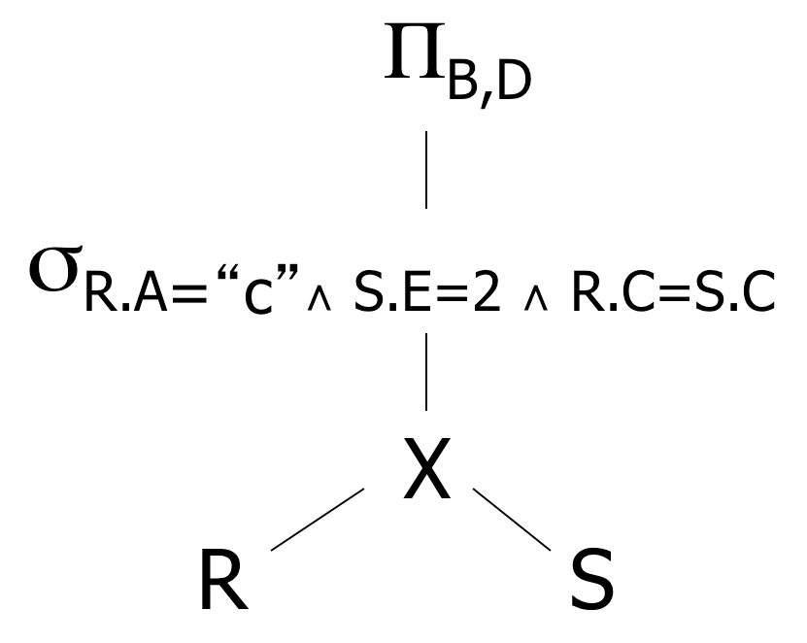
Relational Algebra – Possible Query Plans
Select B, D From R, S Where R.A = “c” And S.E = 2 And R.C=S.C
Plan 1
OR: Π_{B,D} [ σ_{R.A=“c”∧ S.E=2 ∧ R.C = S.C} (RXS)]

Slide 13
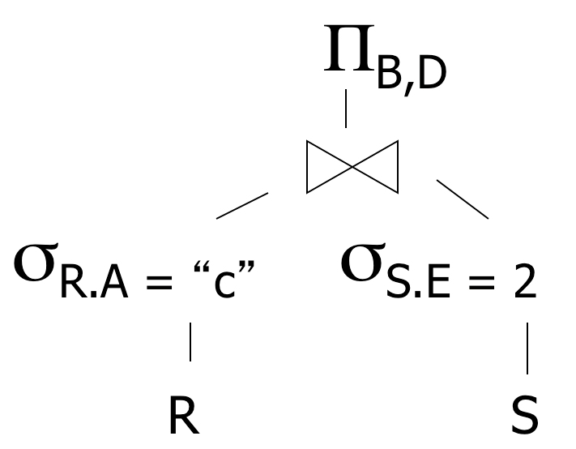
Relational Algebra – Possible Query Plans
Select B, D From R, S Where R.A = “c” And S.E = 2 And R.C=S.C
Plan 2
Natural join
(C is common column)

Slide 14
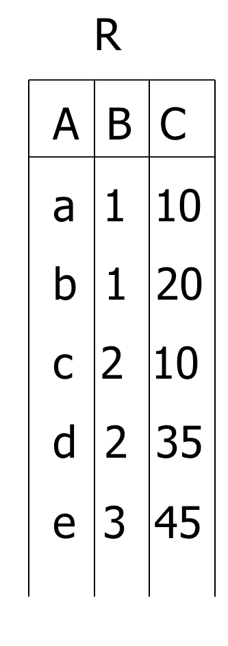
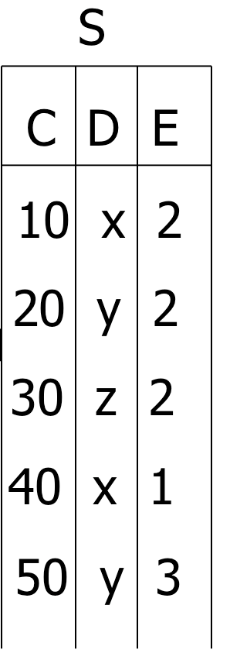
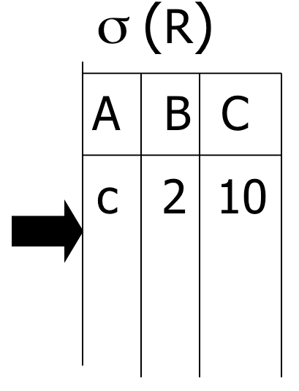
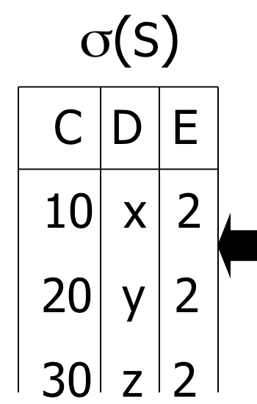

Plan 2
Select B, D From R, S Where R.A = “c” And S.E = 2 And R.C=S.C

Slide 15
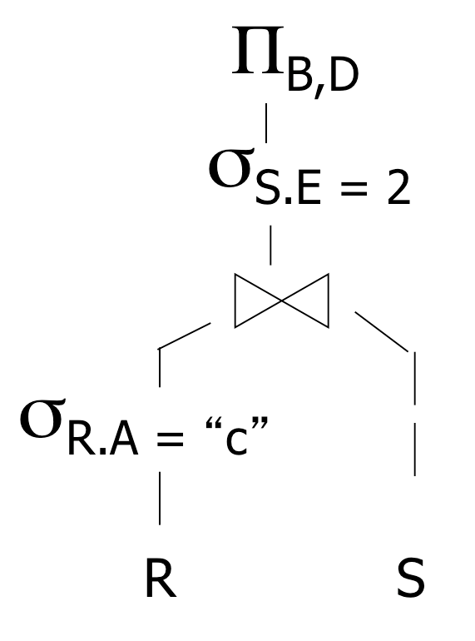
Relational Algebra – Possible Query Plans
Select B, D From R, S Where R.A = “c” And S.E = 2 And R.C=S.C
Plan 3
Assume indexes on R.A and S.C
(1) Use R.A index to select R tuples with R.A = “c”
(2) For each R.C value found, use S.C index to find
matching tuples
Natural join
(3) Join matching R,S tuples
(4) Eliminate S tuples S.E ≠ 2, project B,D attributes and place in result

Slide 16
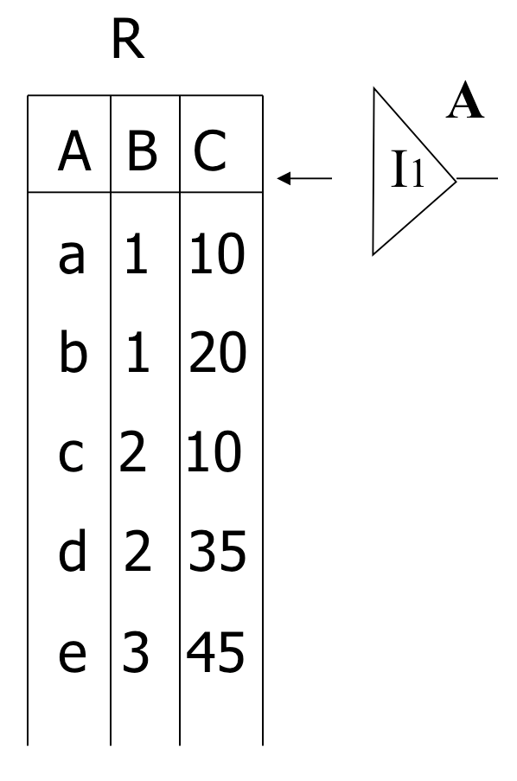
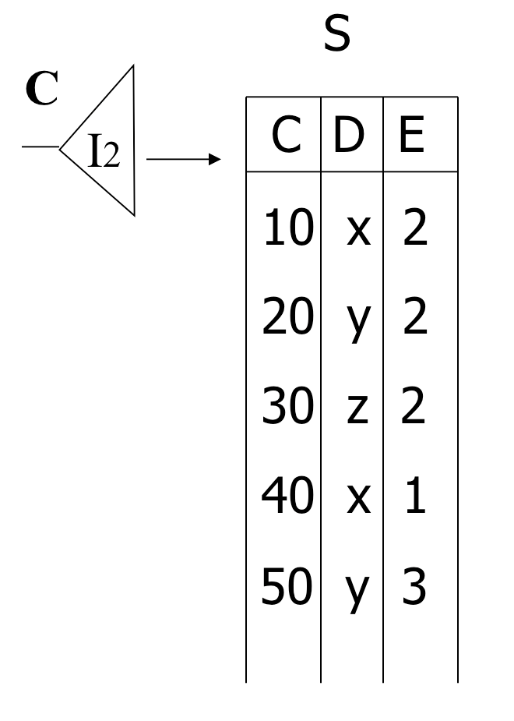
Select B, D From R, S Where R.A = “c” And S.E = 2 And R.C=S.C
Plan 3
=“c”
<c,2,10>
<10,x,2>
Check E=2?
output: <2,x>

Slide 17

Select B, D
From R, S
Where R.A = “c”
And S.E = 2 And R.C=S.C
How to reach from top to bottom?
How to select the best one?

Slide 18
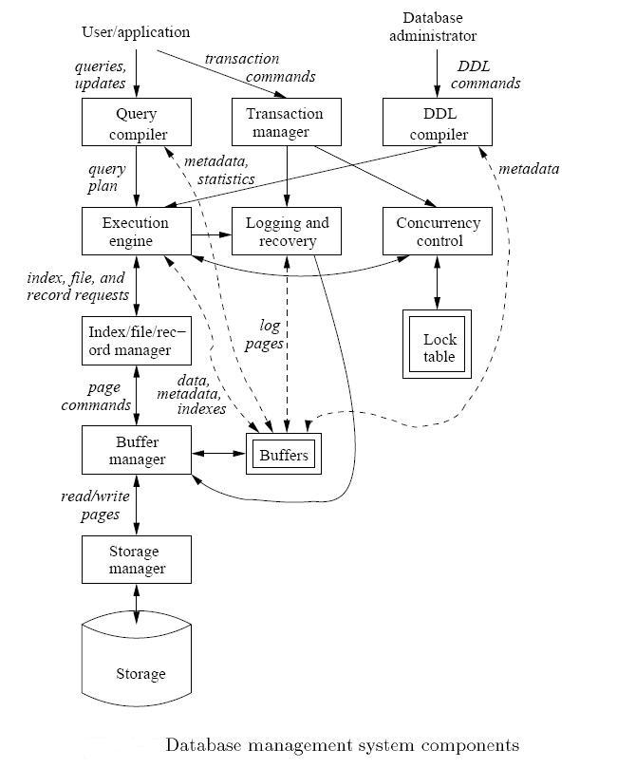
Query Compilation, Optimization and Execution

Slide 19
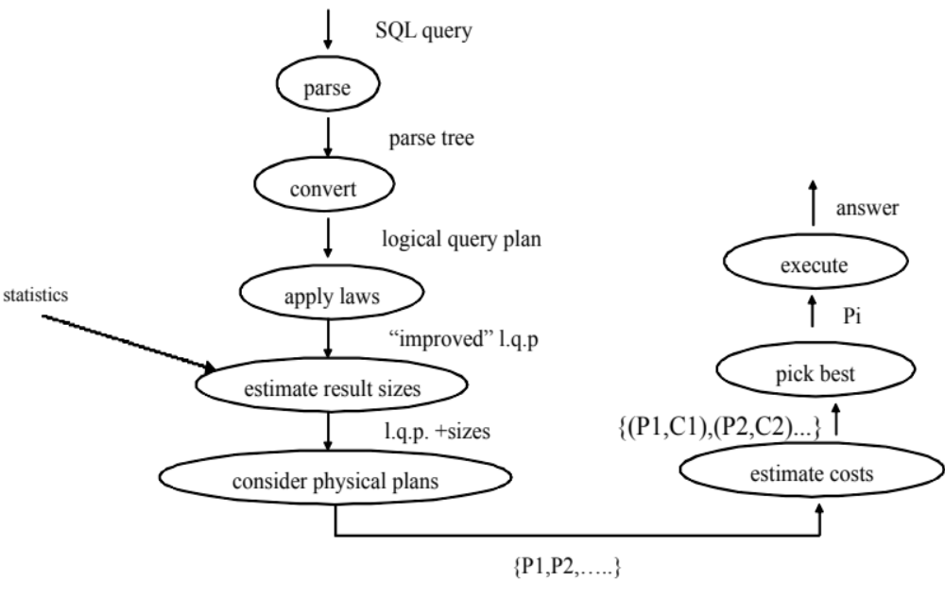
Overview of Query Execution
SQL Query ➔ Compile ➔ Optimize ➔ Execute

Slide 20
Example
Query : Find the movies with stars born in 1960
SELECT title
FROM StarsIn
WHERE starName IN (
SELECT name
FROM MovieStar
WHERE birthdate LIKE ‘%1960’);

Slide 21
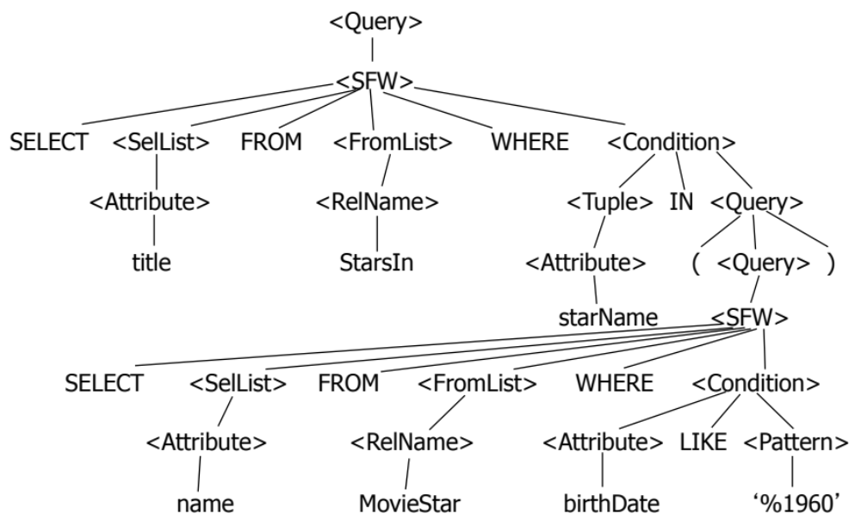
Step 1: Generate Parse Tree

Slide 22
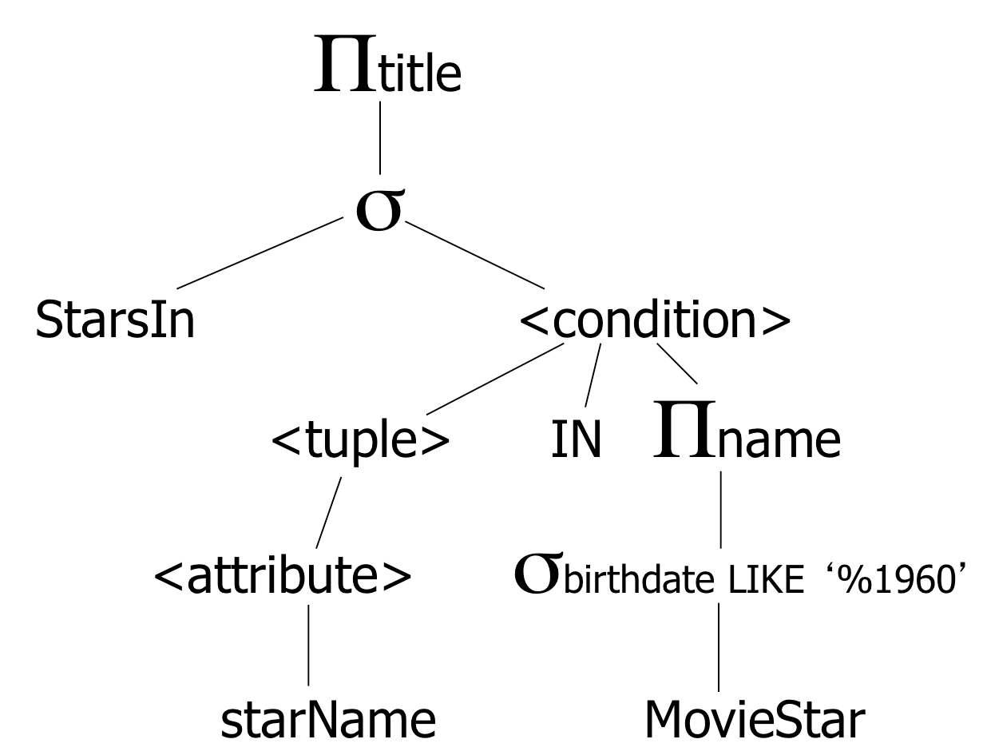
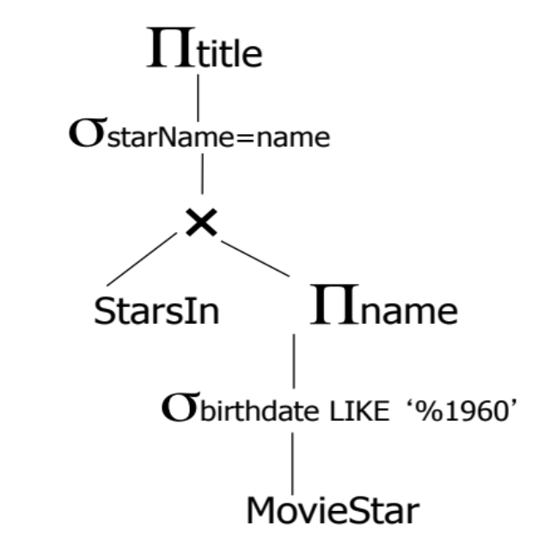
Step 2: Relational Algebra & Logical Plan
SELECT title
FROM StarsIn
WHERE starName IN (
SELECT name FROM MovieStar WHERE birthdate LIKE ‘%1960’);
Expression Tree
Logical Query Plan
Expression Tree is a midway between a parse tree and relational algebra

Slide 23

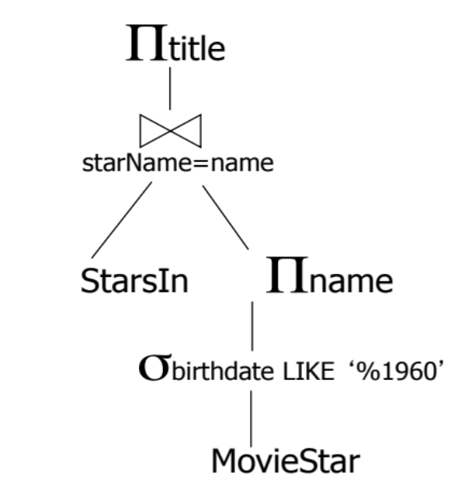
Step 3: Optimize & Create Several Logical Plans
SELECT title
FROM StarsIn
WHERE starName IN (
SELECT name FROM MovieStar WHERE birthdate LIKE ‘%1960’);
Plan 1
Plan 2
Question:
Push project to
StarsIn?

Slide 24

Overview of Query Execution
SQL Query ➔ Compile ➔ Optimize ➔ Execute

Slide 25
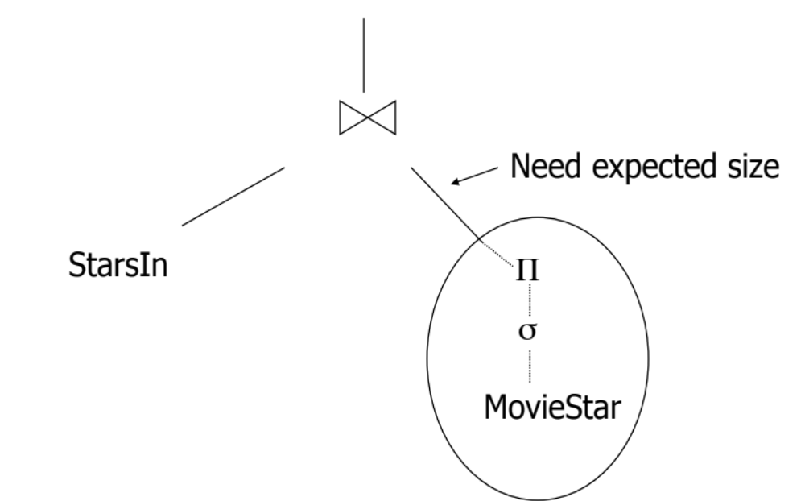
Step 4: Estimate the Sizes
That is done for each plan

Slide 26

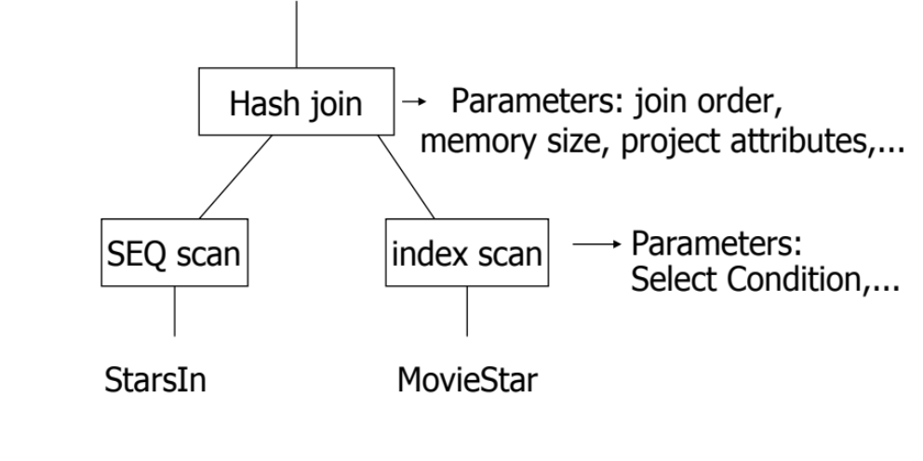
Step 5: Consider Physical Plans
Physical plan means how each operator will execute (which algorithm)
  E.g., Join can be nested-loop, hash-based, merge-based, or sort-based
Each logical plan will map to multiple physical plans
Logical Plan
One Physical Plan

Slide 27
Overview of Query Execution
SQL Query ➔ Compile ➔ Optimize ➔ Execute

Slide 28
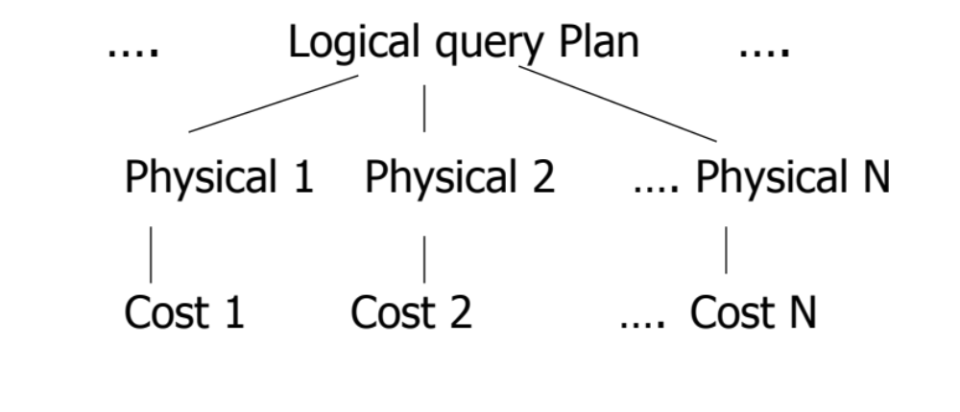
Step 6: Estimate the Cost
This is done for each physical plan
Select the cheapest to execute…

Slide 29
Overview of Query Execution
SQL Query ➔ Compile ➔ Optimize ➔ Execute

